Slide 1
Sensing Soil Moisture Changes with Garden Watering
Under KS Rajan Sir and Pavan Sir -
Akshat Goyal : 2018101075
Kanish Anand: 2018101025
Manish 2018101073

Slide 2
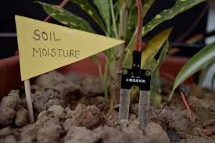
Aim & Objective
To measure and monitor the soil moisture conditions around a plant that is watered regularly and the soil away from it to understand the variations spatially .
This will help us to regulate the watering of plants.

Slide 3
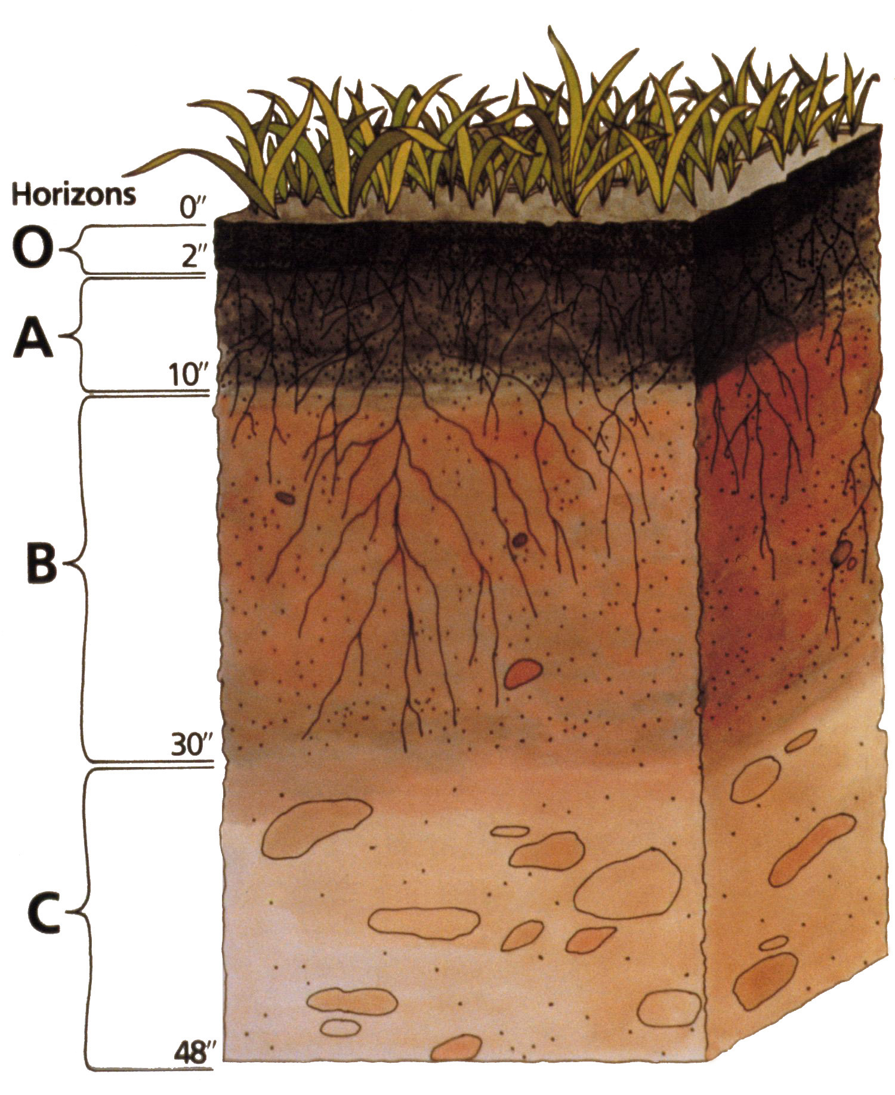
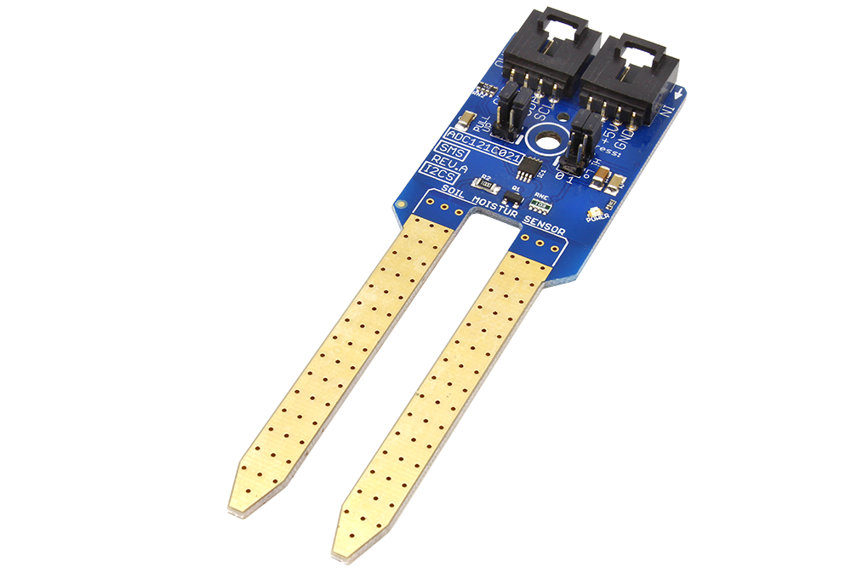
Soil Moisture Sensor
Soil moisture sensors measure the volumetric water content in soil.
Since the direct gravimetric measurement of free soil moisture requires removing, drying, and weighing of a sample.
Soil moisture sensors measure the volumetric water content indirectly by using some other property of the soil, such as electrical resistance or dielectric constant as a proxy for the moisture content.
DFROBOT SEN0114

Slide 4
Working Principle of Moisture Sensor
This moisture sensor uses the two probes to pass current through the soil, and then it reads that resistance to get the relative moisture level.
More water makes the soil conduct electricity more easily (less resistance), while dry soil conducts electricity poorly (more resistance).

Slide 5
Problems with Soil Moisture Sensor
Almost all the sensors will suffer from corrosion when exposed to the media which it is supposed to sense.
In the particular case of the soil moisture sensors, the water plus other compounds presents in the soil, can corrode the electrodes.
This can affect the measurements and/or the operational lifespan of the device itself.
Solutions
The sensor has a fine layer of gold to minimize corrosion.
Stop power to the sensor when is not used and instead of constantly taking inputs, take input after a time interval so as to minimize oxidation.

Slide 6
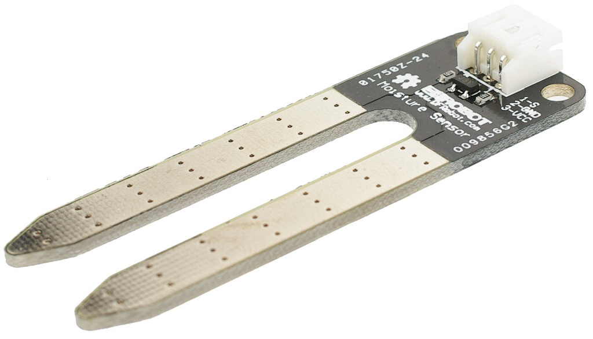
Specifications :
Power supply: 3.3v or 5v
Output voltage signal: 0~4.2v
Current: 35mA
Pin definition:
Analog output(Blue wire)
GND(Black wire)
Power(Red wire)
Size: 60x20x5mm

Slide 7
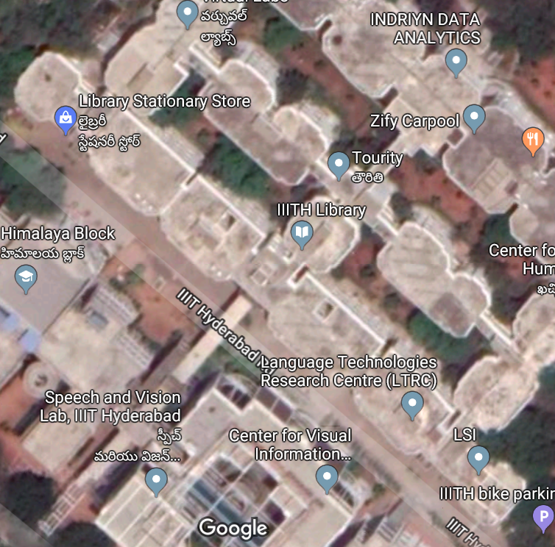
Place of Deployment

Slide 8
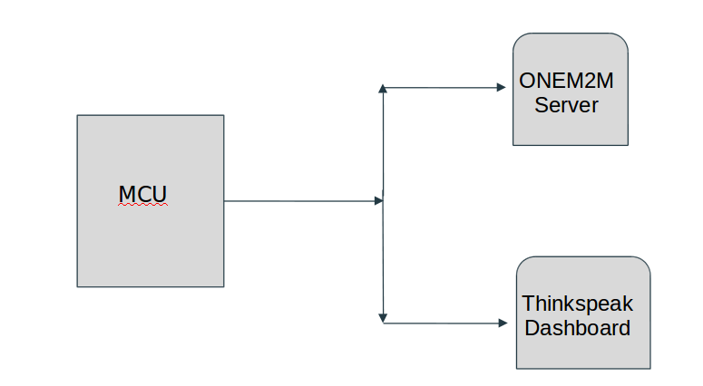
Block Diagram
Soil Moisture 1
(at the boundary of tree)
Soil Moisture 2
(near the roots)
ESP32
Soil Moisture 3
(between two trees)
Soil Moisture 4
(near tree and away from sprinkler)

Slide 9
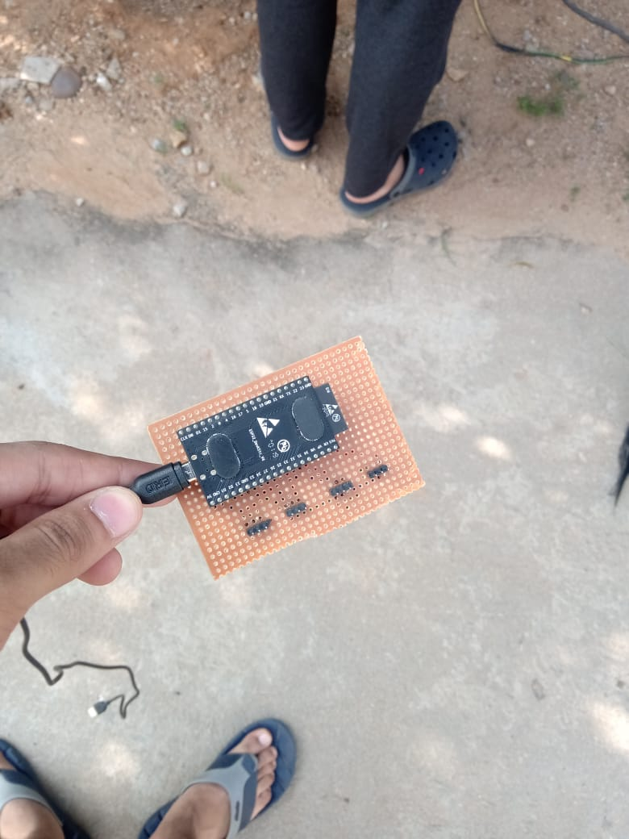
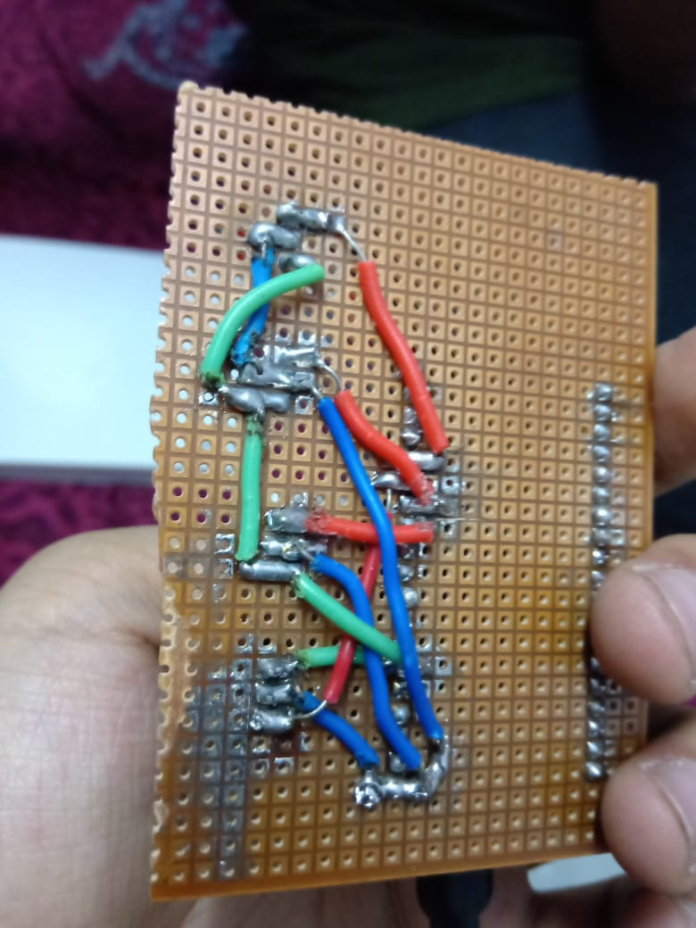
PCB Circuit Design

Slide 10
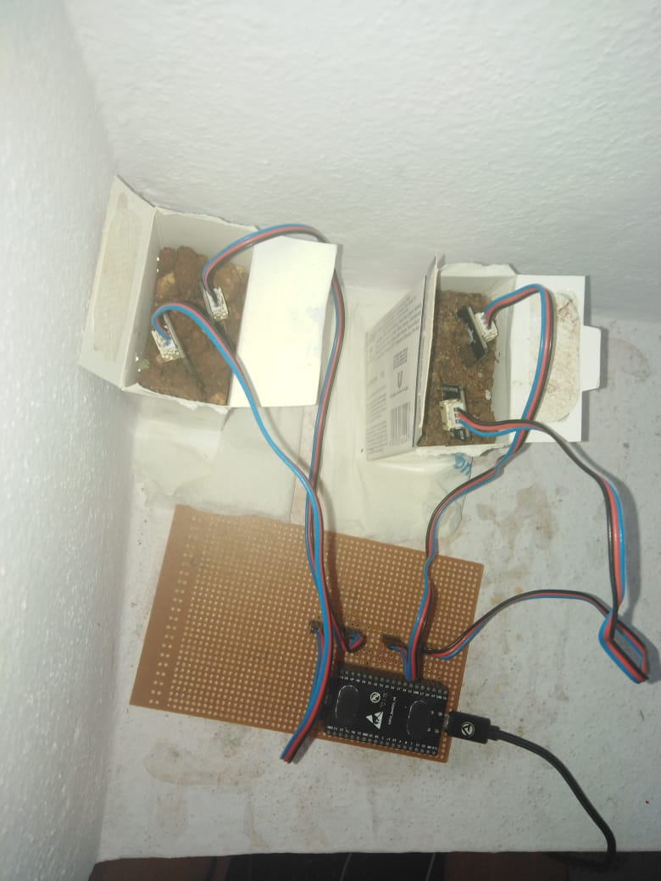
Test Deployment

Slide 11
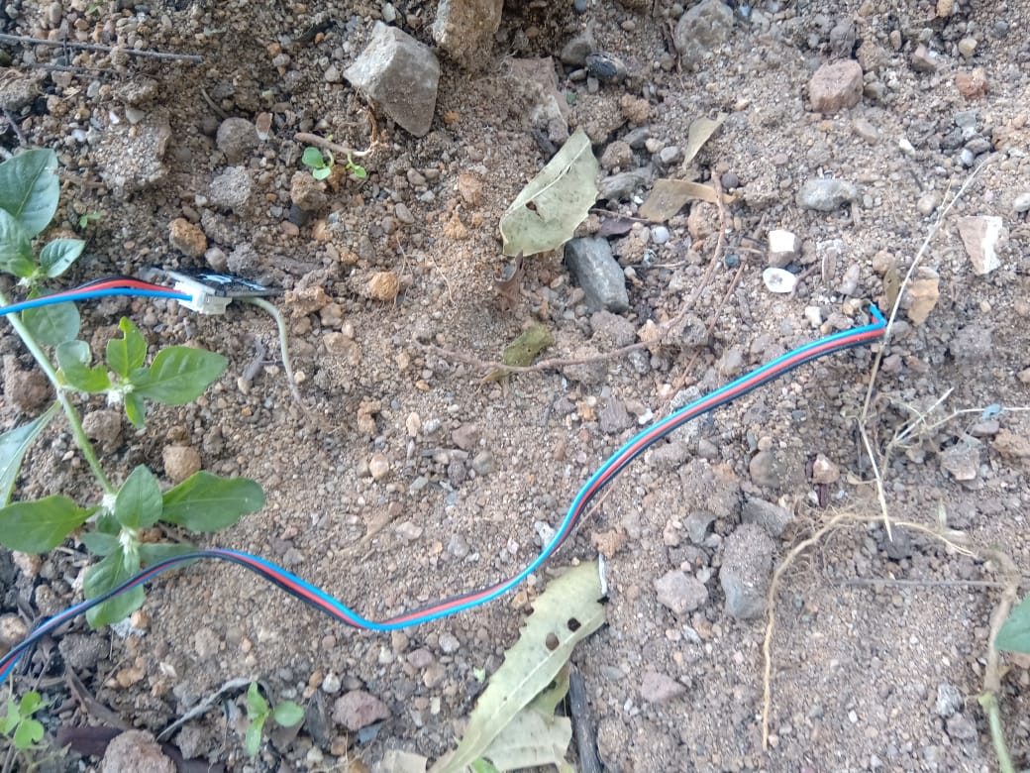
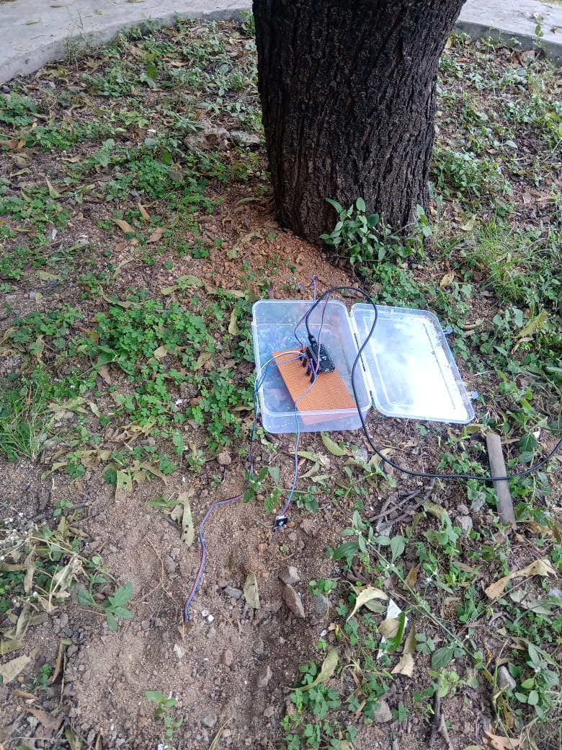
Test Deployment in Bakul

Slide 12
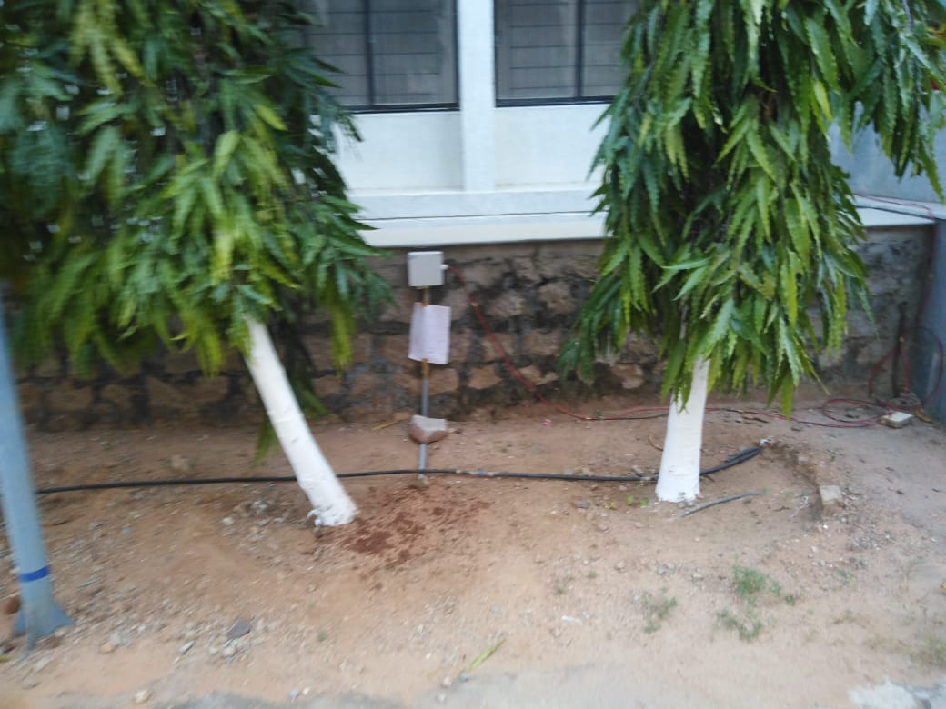
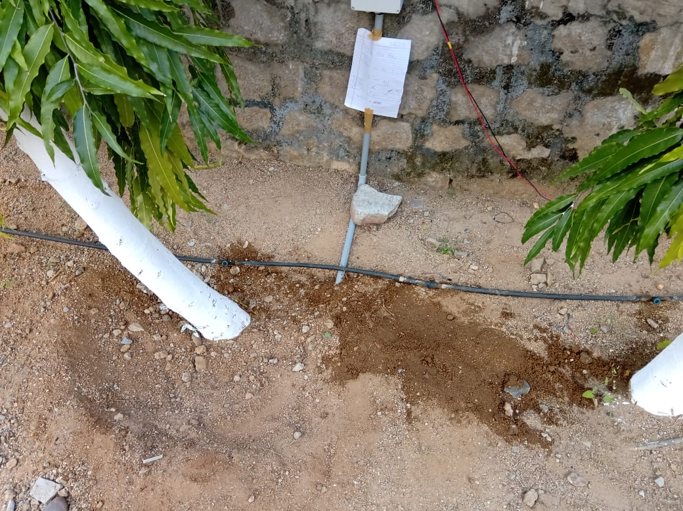
Final deployment
2
3
1
4

Slide 13
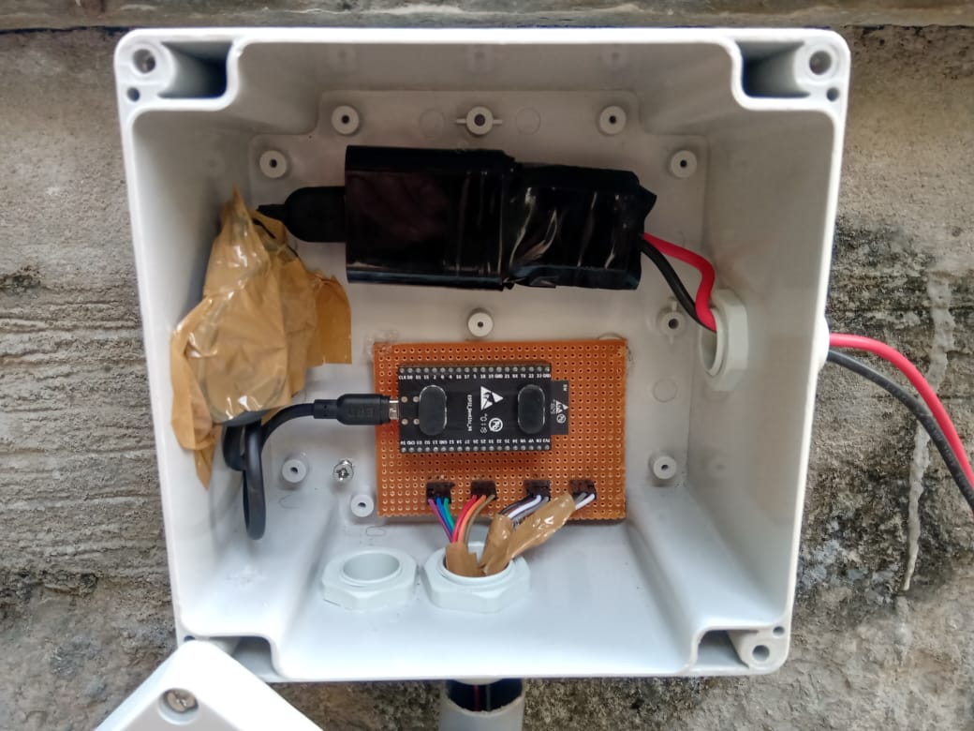
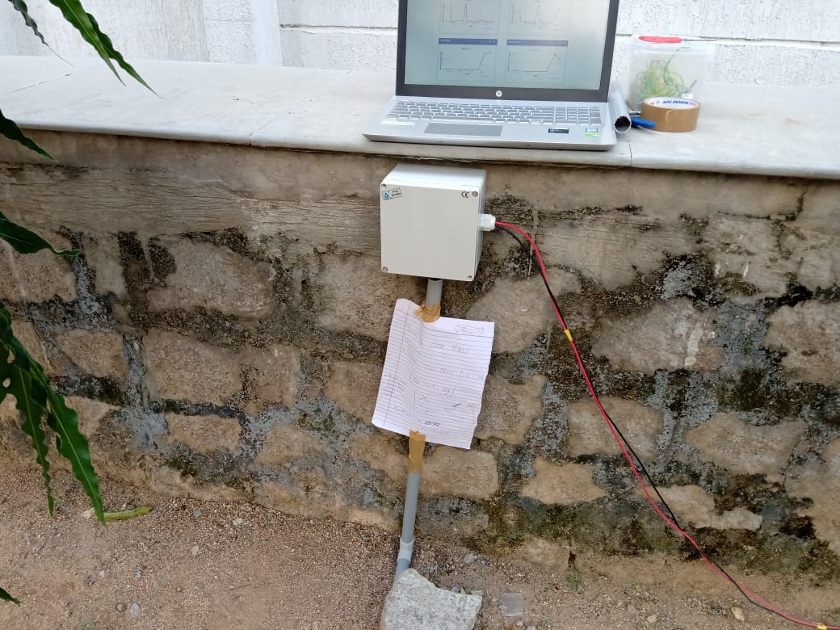
Encloser
As the project had to be deployed outside, so to protect the system from rain, dust and outside environment a solid encloser was required.

Slide 14

Step 1-> Input
Tree 1
Tree 2
Sensor 3
Sensor 4
Sensor 1
Sensor 2
As shown in the above diagram sensors are deployed near the plants/trees and away from them.

Slide 15
Step 2 -> Processing
The readings that we got from the sensors in previous step will be in terms of voltage. So the readings needs to be calibrated.
Also readings from all the sensors will be analysed together and some useful insights will be made.

Slide 16
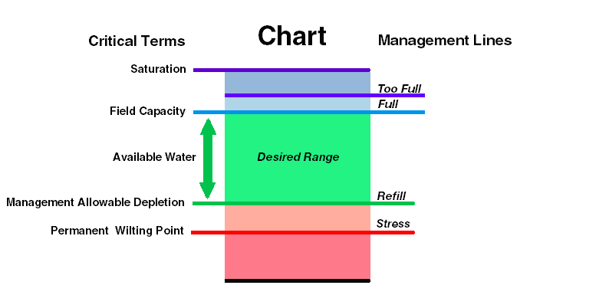
Calibration
4095 MU
As our goal is to analyze and compare the change in soil moisture contents over different areas and time we shift the focus from reliance on calibrated, absolute values to a judicious use of raw sensor data — expressed in arbitrary 'Moisture Units' (MU) — to monitor changes in moisture levels.
3500 MU
2500 MU
700 MU
300 MU

Slide 17
Step 3-> Output (Use case)
The data can be used to water the plants/ trees efficiently.
If we need to plant some flowers/plants, then by analysing the moisture readings we can predict which flowers will be suitable under this water condition.
If the water content of the soil is low then dust particles escape the soil and affect the air quality. So we can prevent this by watering when required.
By collecting data over different areas, we can analyze the soil moisture data at different distances from the trees.

Slide 18
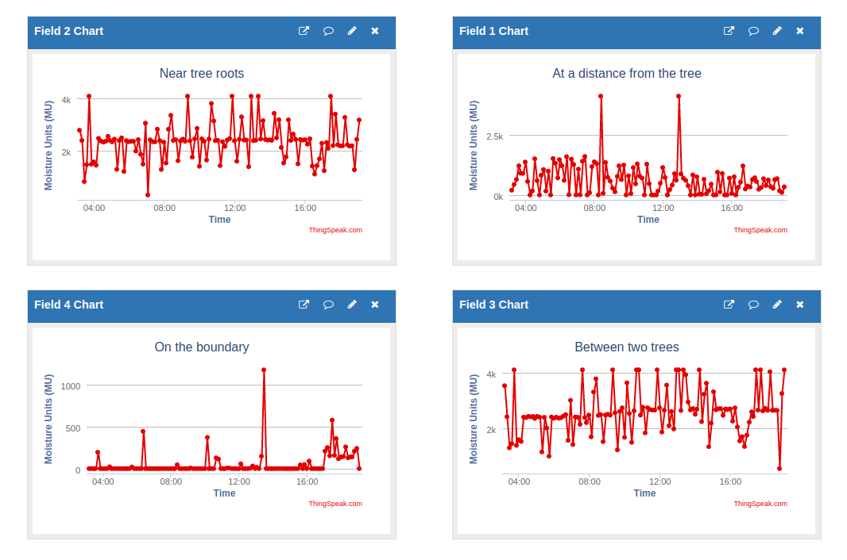

Slide 19
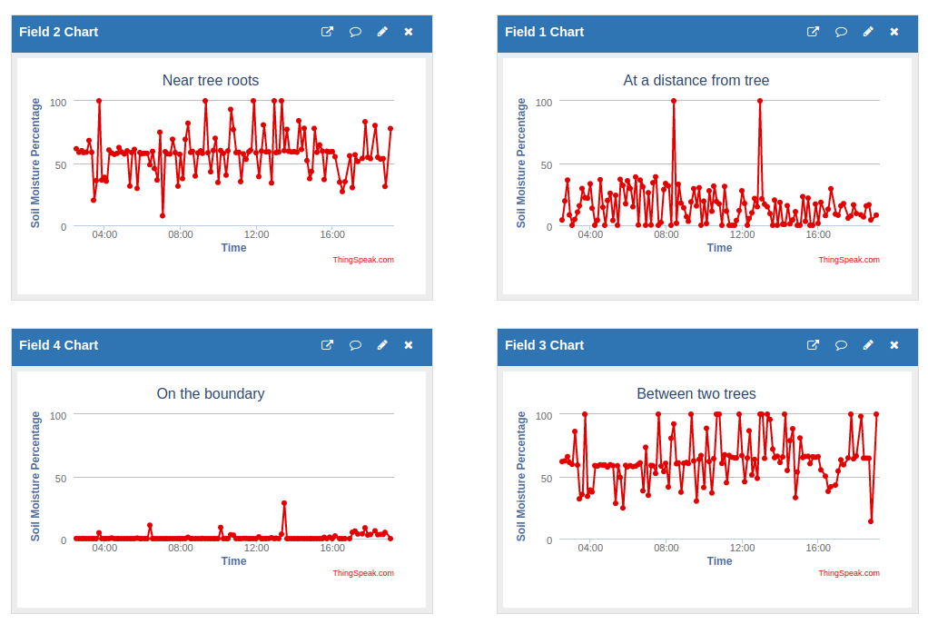
Data mapped to percentage

Slide 20
Thanks

